Slide 1
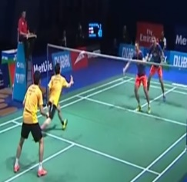
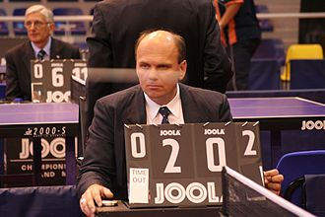
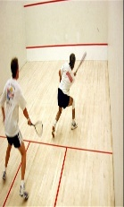
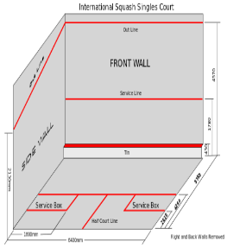
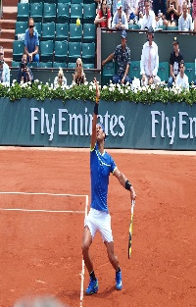
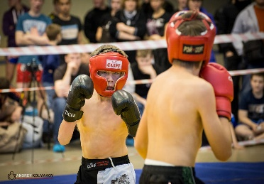
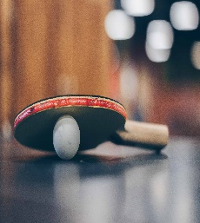
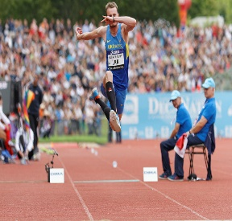
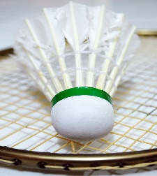
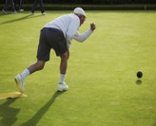
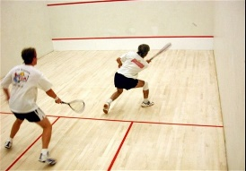
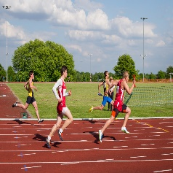
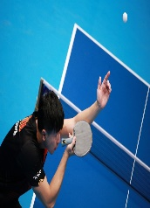
Summer 2
Tennis: Students further enhance skills with a wider focus on competitive matches, tactics and decision making.
Athletics: recap of athletic events from Autumn 1.
KS3 PE
2022-23
Summer 1
Orienteering: students are challenged and encouraged to develop more complex map reading skills from year 8.
Lawn Bowls: Students continue to develop bowling skills & understanding of the rules & tactics
Spring 2
Badminton: Building on skills learnt in year 7&8 with a wider focus on tactics and decision making in both singles and doubles.
Fitness:
PT sessions to encourage students to maximise their movement and promote a healthy active lifestyle.
Autumn 2
Table Tennis: Table tennis remains the main focus for the autumn term. Offering competitive fixtures and wider opportunities for students to refine their skills.
MMA:
Building on skills learnt in year 7&8 with a wider focus on decision making .
Spring 1
Squash: Students continue to refine the core skills of the game and apply attack and defensive shots in a competitive situation.
MMA:
MMA remains the main focus for boys during the autumn and spring term. Offering opportunities for students to challenge their skills and physical ability.
Autumn 1
Athletics: students take part in more competition. Using technology to help coach and ensure correct technique is used when throwing or jumping.
Lawn Bowls: Students refine their bowling skills & understanding of specific rules & tactics.
Summer 2
Tennis: Students develop the key skills such as service, forehand and backhand as well as understanding coaching points of technique.
Athletics: recap of athletic events from Autumn 1.
Summer 1
Orienteering: students are challenged and encouraged to develop more complex map reading skills from year 7.
Lawn Bowls: Students continue to develop bowling skills & understanding of the rules & tactics
YEAR
9
RIME
Spring 1
Squash: Focus on core skill development such as serve, forehand, backhand and an understanding of the basic rules of the game.
MMA:
Students continue to embed the basic elements of punching and kicking.
Spring 2
Badminton: Building on skills learnt in year 7 with a wider focus on tactics and decision making in both singles and doubles.
Fitness:
PT sessions to encourage students to maximise their movement and promote a healthy active lifestyle.
Autumn 2
Table Tennis: Students continue to develop the core skills alongside a deeper understanding of the various tactics of the game.
MMA:
Students embed kicking, punching and sparring techniques of MMA.
Autumn 1
Athletics: students start to embed the technique for throwing, jumping and running events. Intra school competition for students to challenge themselves.
Lawn Bowls: Students continue to develop bowling skills & understanding specific rules & tactics.
YEAR
8
Summer 2
Tennis: Focus on basic skill development such as forehand, backhand and an understanding of the rules of the game.
Athletics: recap of athletic events from Autumn 1.
Summer 1
Orienteering: students gain an understanding of reading maps and increase the amount of exercise they do.
Lawn Bowls: Students develop bowling skills & understanding of the rules & tactics
Spring 2
Badminton: Main focus is hand eye co-ordination allowing students to develop key skills such as serving, overhead clear & forehand /backhand shots.
Fitness:
Students will focus on stamina, strength and muscular endurance during PT sessions
YEAR
7
Autumn 1
Athletics: students gain an understanding of each athletic event, being able to apply coaching points and attempt to transfer this into a practical performance.
Lawn Bowls: Students develop bowling skills & understanding of the rules & tactics
Autumn 2
Table Tennis: Focus on basic skill development such as serve, forehand, backhand and an understanding of the basic rules of the game.
MMA:
students learn the basic elements of punching, kicking and MMA.
Spring 1
Squash: Students learn the skills and tactics of a completely new game. Key skills involve serving, hitting and receiving.
MMA:
students learn the basic elements of punching, kicking and MMA.
Coming From Key Stage 2; Referral; Induction
Broadening Sporting Experiences & Encouraging Enjoyment in Physical Activity.

