Slide 1
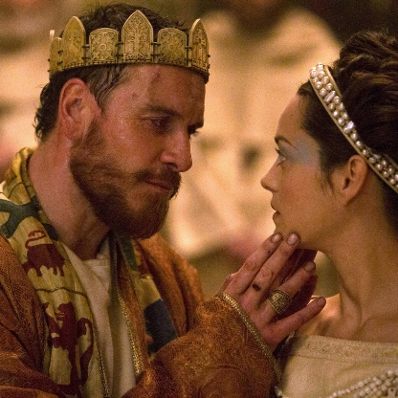
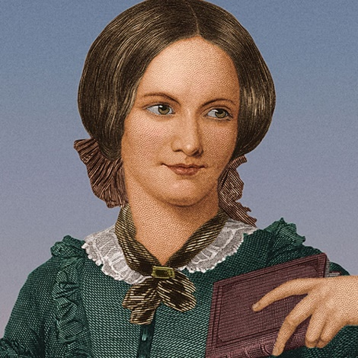
ENGLISH
2022-23
Summer 2 GCSEs
Summer 1
Final Preparation
Individual focus on exam skills with practising exam technique and timings.
REVISION
Spring 2
Fantasy Writing
(Paper 1)
Sport
(Paper 2)
Reinforcement of writing and reading techniques and exam preparation
Autumn 2
Q5 – Write a story about someone arriving somewhere new.
EDUCATION (Intro to Paper 2)
Knife Crime task to baseline writing
Developing non-fiction reading, summarizing and evaluating with a focus on 19th Century
Use of articles about schools in the past and in the present
Complete Q1-4 of past paper.
POETRY
AQA
LITERATURE
‘An Inspector Calls’
Autumn 2
Q5 – Write a story about someone arriving somewhere new.
EDUCATION (Intro to Paper 2)
Knife Crime task to baseline writing
Developing non-fiction reading, learning to summarize and read for implicit meaning with a focus on 19th Century
Use of articles about schools in the past and in the present
Complete Q1-4 of past paper.
Autumn 1 NEW ARRIVALS (Paper 1)
Baseline – Creative writing
Identifying and summarizing key information and appropriate comments using, ‘The Landlady’ Roald Dahl and/or ‘Brick Lane’ by Monica Ali, ‘Small Island’ by Andrea Levy and ‘The Kite Runner’ by Khalid Hosseini
Half-term assessment:
Year 10 – June 2017 Q1-4
LITERATURE ‘Macbeth’ and ‘A Christmas Carol’
YEAR
11
ACCESS ARRANGEMENTS
Summer 2 - A Novel
Reading a novel for pleasure with close reading activities to develop implicit and explicit understanding
Links with paper 2 – non fiction writing
Spelling Punctuation and Grammar
Literacy and SEMH support for students according to need
Summer 1
FUNCTIONAL SKILLS PREPARATION
Reading – Level 1 and 2 exam specific terminology
Writing – for Functional Skills
Speaking and Listening – research personal topic for individual presentation
POETRY
AQA
Spring 2
CRIME
(Link with skills for Paper 1 and Paper 2 reading and writing tasks)
Improving accuracy in close reading of implicit meaning. Links also made to PSHCE. Texts to include: ‘The Guest List’ by Lucy Foley, ‘’The Beat Goes On’ by Ian Rankin, Unsolved mysteries of crime, ‘My Life on Devil’s Island’.
LITERATURE
‘An Inspector Calls’
Spring 1 EDUCATION and FUNCTIONAL SKILLS
(Paper 1 and 2 and Functional Skills)
Q5 – Write an article about what makes a good education and/or Write an article in which you argue for or against about preparing students for work: Beginning to analyze implicit meaning using texts including ‘Jane Eyre’, ‘Roll of Thunder, Hear my Cry’,
YEAR
10
LITERATURE ‘Macbeth’ and ‘A Christmas Carol’
Autumn 2
Q5 – Write a story about someone arriving somewhere new.
EDUCATION (Intro to Paper 2)
Knife Crime task to baseline writing
Developing non-fiction reading, learning to summarize with a focus on 19th Century
Use of articles about schools in the past and in the present
Complete Q1-4 of past paper.
Autumn 1 NEW ARRIVALS (Paper 1)
Baseline – Creative writing
Identifying and summarizing key information and making simple comments using, ‘The Landlady’ Roald Dahl and/or ‘Brick Lane’ by Monica Ali, ‘Small Island’ by Andrea Levy and ‘The Kite Runner’ by Khalid Hosseini
Half-term assessment:
Year 10 – June 2017 Q1-4
‘Education is the most powerful weapon with which you can change the world. ~Nelson Mandela
Let us remember: One book, one pen, one child, and one teacher can change the world. ~Malala Yousafzi

